Slide 1
Correlation

Slide 2
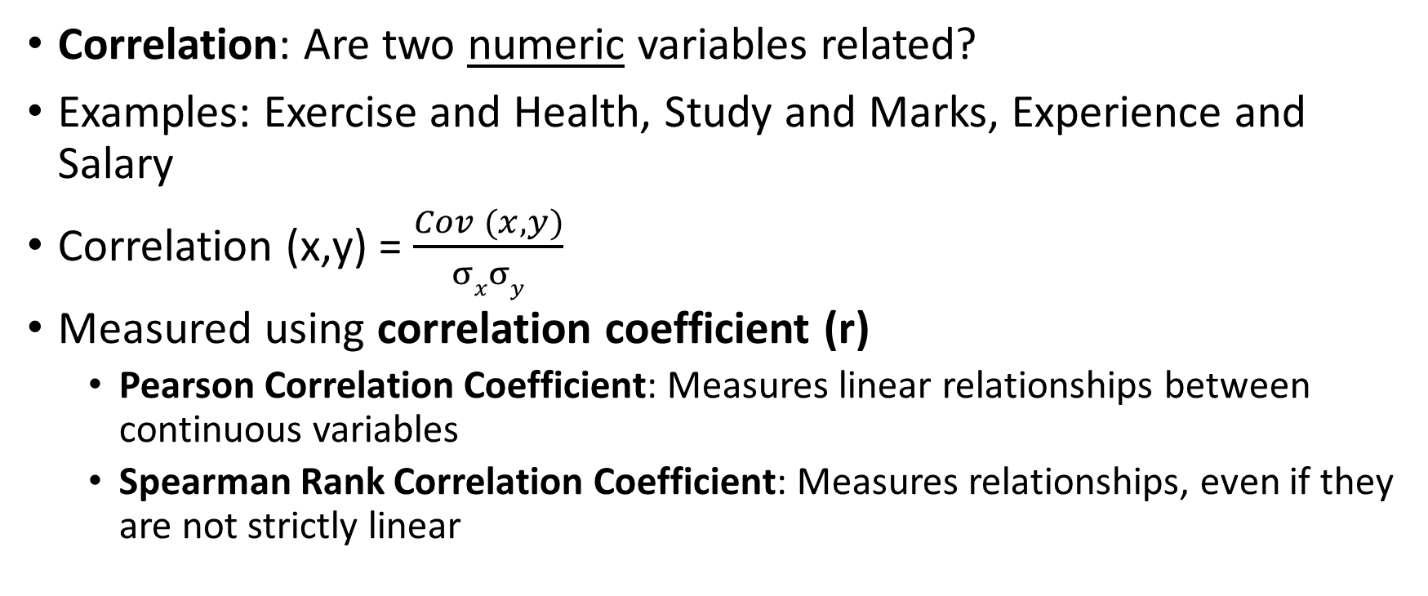
Correlation
Correlation: Are two numeric variables related?
Examples: Exercise and Health, Study and Marks, Experience and Salary
Correlation (x,y) = $\frac{Cov (x, y)}{σxσy}$
Measured using correlation coefficient (r)
Pearson Correlation Coefficient: Measures linear relationships between continuous variables
Spearman Rank Correlation Coefficient: Measures relationships, even if they are not strictly linear

Slide 3
Pearson Correlation Coefficient Interpretation
Range: -1 to +1
Positive correlation: Variables move up together
Example: Correlation of 0.80 between Hours spent studying and test scores
Negative correlation: As one variable moves up, the other moves down
Example: Correlation of -0.70 between Hours spent watching TV and physical fitness
Zero correlation: Variables are unrelated
Example: Correlation of 0.02 between Shoe size and IQ score

Slide 4
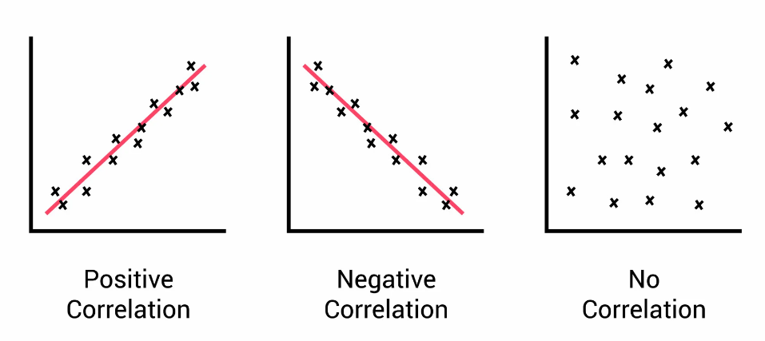
Positive, Negative, No Correlation

Slide 5

Pearson Correlation Coefficient for Earlier Example
Height | Weight
65 | 68
67 | 69
68 | 70
66 | 69
64 | 65
Corr(x,y) = $\frac{Cov (x, y)}{σxσy}$
Corr(x,y) = $\frac{2.75}{1.58 x 1.92}$
Corr(x,y) = $\frac{2.75}{1.58 x 1.92}$ = 0.90

Slide 6
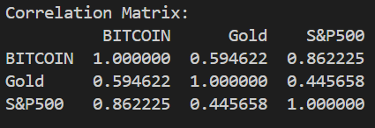
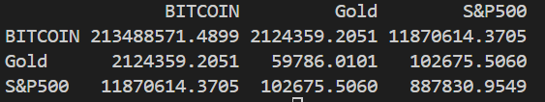
Covariance Example
C:\code\Data Analytics\correlation-covariance-crypto-gold.py
Interpretation: Correlation
Interpretation: Covariance

Slide 7
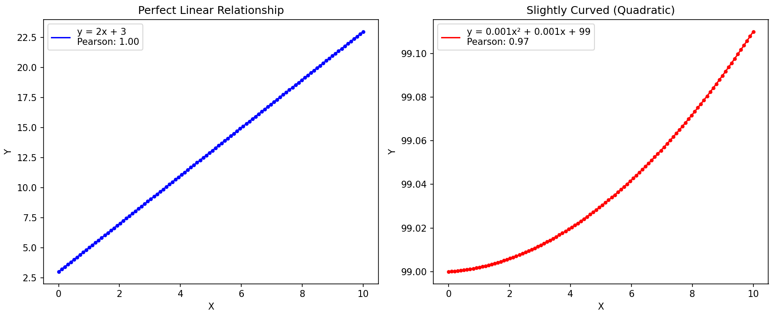
Why Spearman Rank Correlation?
Pearson correlation coefficient: Works well when data is linear, but not well when the data is not linear

Slide 8
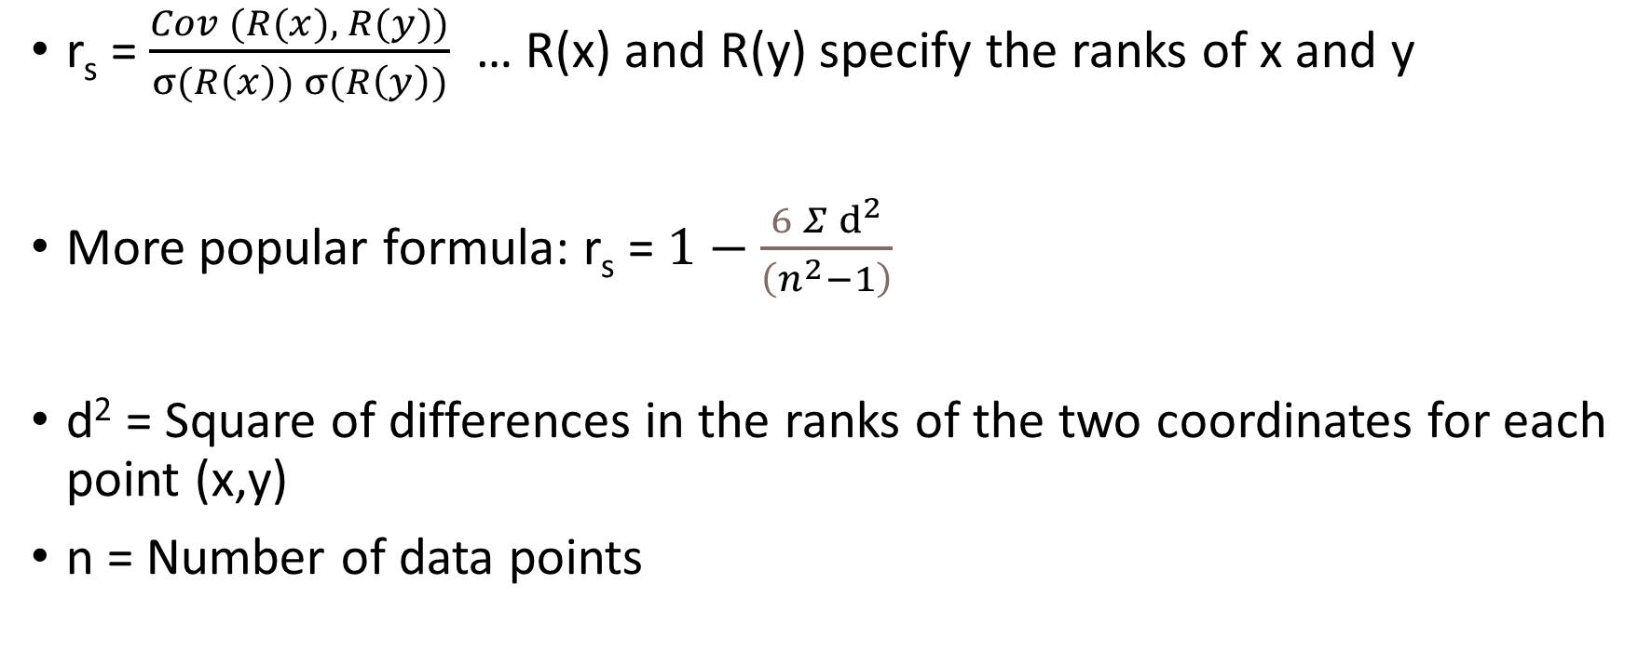
Spearman Rank Correlation
r_{s} = $\frac{Cov (R(x), R(y))}{σ(R\left(x\right)) σ(R\left(y\right))}$ … R(x) and R(y) specify the ranks of x and y
More popular formula: r_{s} = $1−\frac{6 Σⅆ^{2}}{\left(n^{2}−1\right)}$
d² = Square of differences in the ranks of the two coordinates for each point (x,y)
n = Number of data points

Slide 9
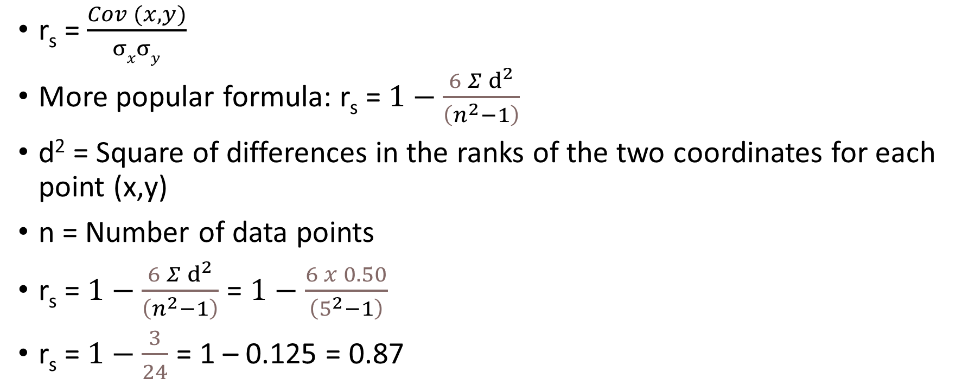
Spearman Rank Correlation Coefficient for Earlier Example
Height | Weight
65 | 68
67 | 69
68 | 70
66 | 69
64 | 65
r_{s} = $\frac{Cov (x, y)}{σxσy}$
More popular formula: r_{s} = $1−\frac{6 Σⅆ^{2}}{\left(n^{2}−1\right)}$
d² = Square of differences in the ranks of the two coordinates for each point (x,y)
n = Number of data points
r_{s} = $1−\frac{6 Σⅆ^{2}}{\left(n^{2}−1\right)}$ = $1−\frac{6 x 0.50}{\left(5^{2}−1\right)}$
r_{s} = $1−\frac{3}{24}$ = 1 – 0.125 = 0.87
x_{i} | R_{x} | y_{i} | R_{y} | d_{i} = R_{x} - R_{y} | d_{i}²
65 | 2 | 68 | 2 | 0 | 0
67 | 4 | 69 | 3.5 | 0.5 | 0.25
68 | 5 | 70 | 5 | 0 | 0
66 | 3 | 69 | 3.5 | -0.5 | 0.25
64 | 1 | 65 | 1 | 0 | 0

Slide 10
Population and Sample, Probability Theory

Slide 11
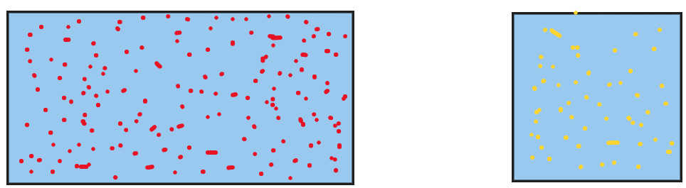

Sampling and Population
Population (N) = Complete data Sample (n) = Subset of data
Estimation: From sample mean -> Population mean, i.e. $\overline{x}→u$
Point estimate: Exact estimate, Interval estimate: A range of estimates (Called Confidence interval)

Slide 12
Population and Sample
Sampling
Population
Sample
Sample statistic (x̄)
Estimate
Population parameter (μ)
10000 students in a university
Question: What is the average student height?
Difficult: Measure the actual height of the population, i.e. all 10000 students to calculate the average (parameter)
Easier: Take a sample of 500 students, calculate the average and use it to estimate the population average (statistic)
Population Parameter | Symbol | Sample Statistic | Symbol
Mean | μ (Mu) | Sample Mean | x̄ (x bar)
Standard Deviation | σ (Sigma) | Sample Standard Deviation | s
Proportion | π (Pi) | Sample Proportion | p̂ (p-hat)

Slide 13
Sampling Types
Univariate Sampling | Bivariate Sampling
Analysis of a single variable | Analysis of two variables to find relationship between them
Analyzing the ages of individuals in a population Examining the heights of a sample of students Studying the test scores of students in a class | Amount of time spent studying (variable 1) and the Test scores achieved (variable 2) Education (variable 1) and the Income level (variable 2)
Descriptive statistics such as mean, mode, median, variance, standard deviation | Correlation, Regression
Histogram, Box plot | Scatter plot, Heatmap

Slide 14
Resampling
Resampling: Modifying a dataset by changing its size or composition
How? Bootstrapping or Cross-validation
Bootstrapping: Draw random samples from the original data using replacement
Cross-validation: Split data into training set and a testing set
Example: K-fold cross validation
Divide data into k subsets (folds), e.g. sample 1, 2, and 3
Train the model on k-1 folds and tested on the remaining fold (e.g. Training: 1,2 and Test 3)
Repeat the process k times
Oversampling: Increase the size of the minority class by duplicating samples or generating synthetic data
Example: SMOTE (Synthetic Minority Oversampling Technique): Handles imbalanced datasets, where the minority class has significantly lower samples than the others (Code: gender-smote.py and smote.py)

Slide 15
Sampling Techniques
Probability sampling: Random selection
Every member of the population has a chance of being selected
Most appropriate
Mainly used in quantitative research
Non-probability sampling: Non-random selection
Not every individual has a chance of being included
Easier and cheaper to access, has a higher risk of sampling bias
Used in qualitative research

Slide 16
Probability Sampling
Type | Brief description | Method | Example
Simple | Every member of the population has an equal chance | Random number generator | Just pick n random samples from 1 million credit card transactions
Systematic | Similar but easier | Choose at regular intervals | Pick order number # 7, 17, 27, 37, 47, …
Stratified | More representative, if we have sub-categories within data | Divide population into strata (sub-groups) and then pick proportionate samples from each | From 5 different income groups, select proportionate samples
Cluster | Similar, but use entire sub-groups, rather than samples within sub-groups | Divide population into clusters and pick entire clusters as samples | Select 5 different branches of a bank out of say 25 and consider all the customers from these 5 branches

Slide 17
Non-Probability Sampling
Type | Brief description | Method | Example
Convenience | Just pick sample data as per one’s convenience | No systematic method | To research opinions about student support services in our university, we ask our fellow students to complete a survey on the topic
Voluntary-response | People voluntarily come forward | Start with the people who are interested – May be biased | Ask employees about problems faced through a third-party survey – unhappy employees will come forward on their own
Purposive | Done for a specific purpose, also called judgment sampling | Reach the right people and then do a detailed study | We want to know the opinions of foreign students at C-DAC, so we specifically talk to them about a variety of topics
Snowball | Recruit more participants via existing participants | Create a snowball of participants | Homeless people survey – Initially difficult to find such people to speak – But they may help us speak with others soon

Slide 18
Sample Space and Events, Probability

Slide 19
Sample Space and Events
Sample space: All the possible outcomes of an experiment
Event: A subset of the sample space
Sample space (S)
Event (E)

Slide 20
Events and Sample Space: Examples
Consider students in our class
Presence event
present
absent
Activeness event
active
inactive
Sample space
{(present, active), (present, inactive), (absent, active), (absent, inactive)}

Slide 21
Probability Definition
Impossible
Equal chance
Certain
0%
50%
100%
0
0.5
1
Probability: How likely it is that something will occur?
Written as a number or fraction (e.g. 0.5 or 50%)
Example:
What is the probability that it will rain today?
Sample space (S) = {R, NR}
P(R) = 1 / 2 = 0.5 or 50%
P(NR) = 1 / 2 = 0.5 or 50%
But what about rainy season?
It should be: P(R) = 100% and P(NR) = 0%
Theoretical probability: What will happen in theory?
Empirical/Practical probability: What actually happened?
Theoretical probability
Empirical probability

Slide 22
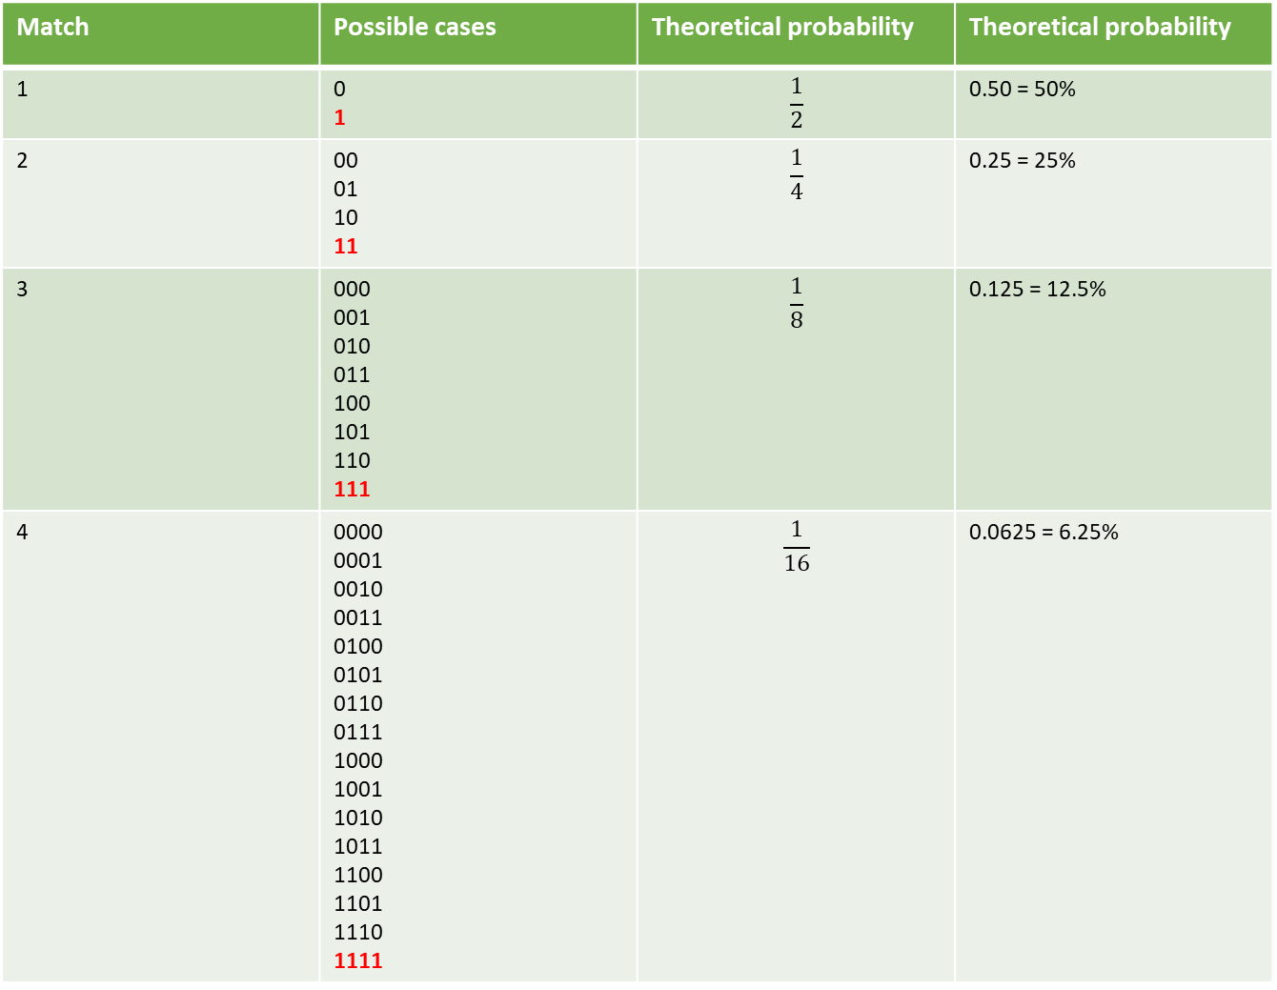
A team winning consecutive matches (Symbols: Win = 1, Loss = 0)
Match | Possible cases | Theoretical probability | Theoretical probability
1 | 0 1 | $$\frac{1}{2}$$ | 0.50 = 50%
2 | 00 01 10 11 | $$\frac{1}{4}$$ | 0.25 = 25%
3 | 000 001 010 011 100 101 110 111 | $$\frac{1}{8}$$ | 0.125 = 12.5%
4 | 0000 0001 0010 0011 0100 0101 0110 0111 1000 1001 1010 1011 1100 1101 1110 1111 | $$\frac{1}{16}$$ | 0.0625 = 6.25%
Imagine the team actually winning four consecutive matches
Theoretical probability would diminish to 6.25%
But the team has actually won! So, the empirical probability will be 100%

Slide 23
Marginal, Joint, Conditional Probability

Slide 24

Basic Terms
Independent events: Outcome of Event A does not impact the outcome of Event B
We take out one marble, note its colour, put the marble back (called replacement)
We then take out a second marble and note its colour
What is the probability that both are red?
Dependent events: Outcome of Event A does impact the outcome of Event B
We take out one marble, note its colour, do not put the marble back (no replacement)
We then take out a second marble and note its colour
What is the probability that both are red?

Slide 25
Basic Terms
Marginal probability: Probability of an event irrespective of the outcome of another variable: P(A)
Joint probability: Events A and B are happening together, whether they are independent or dependent: P(A,B)
Independent events: If A and B are independent, P(A,B) = P(A) x P(B)
Dependent events: If A and B are dependent, P(A,B) = P(A) x P(B|A), where P(B|A) is the conditional probability of B given A

Slide 26
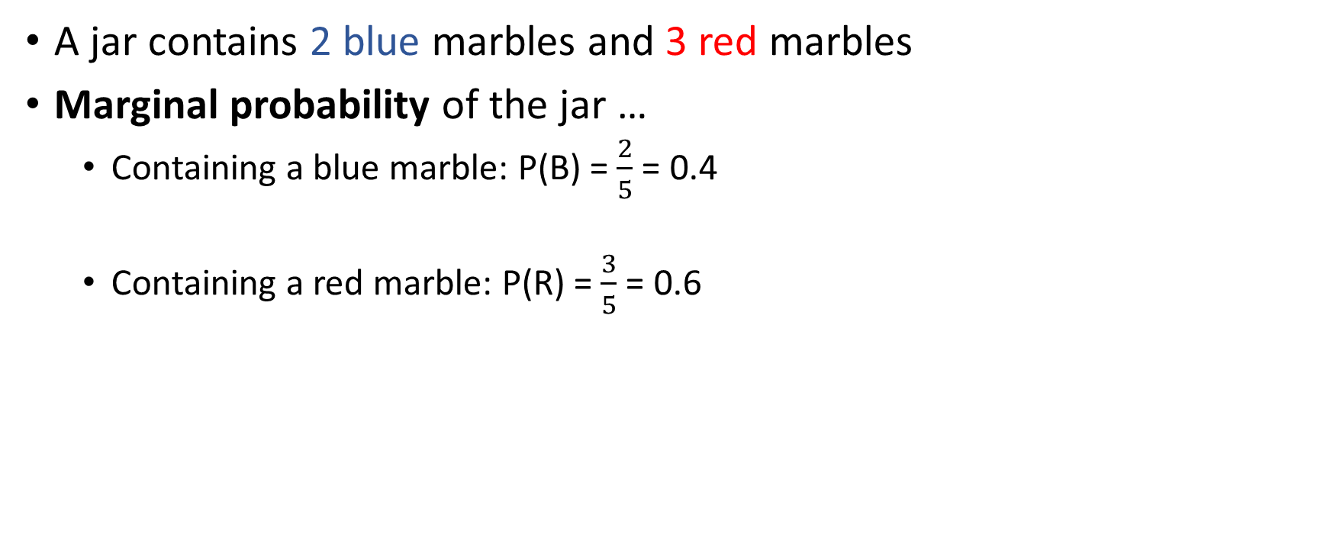
Marginal Probability
A jar contains 2 blue marbles and 3 red marbles
Marginal probability of the jar …
Containing a blue marble: P(B) = $\frac{2}{5}$ = 0.4
Containing a red marble: P(R) = $\frac{3}{5}$ = 0.6

Slide 27
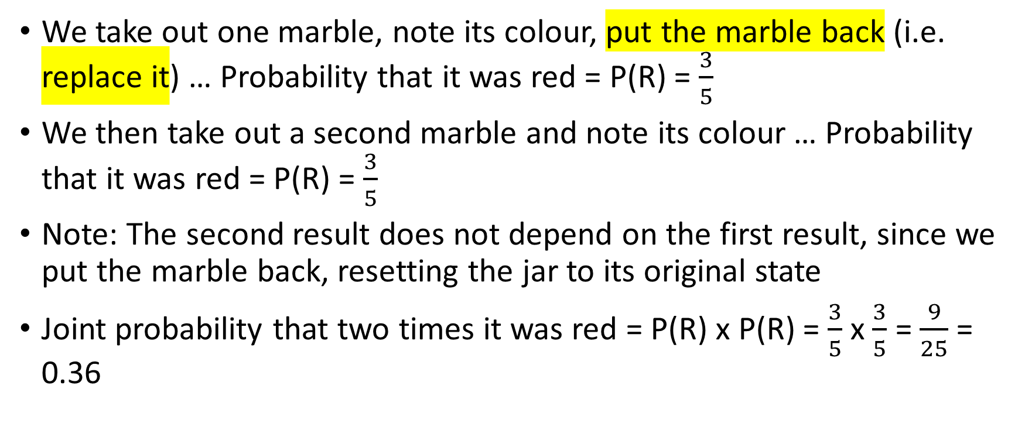
Joint Probability of Independent Events
We take out one marble, note its colour, put the marble back (i.e. replace it) … Probability that it was red = P(R) = $\frac{3}{5}$
We then take out a second marble and note its colour … Probability that it was red = P(R) = $\frac{3}{5}$
Note: The second result does not depend on the first result, since we put the marble back, resetting the jar to its original state
Joint probability that two times it was red = P(R) x P(R) = $\frac{3}{5}$ x $\frac{3}{5}$ = $\frac{9}{25}$ = 0.36

Slide 28
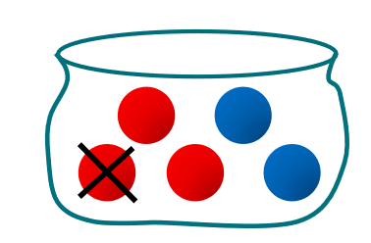
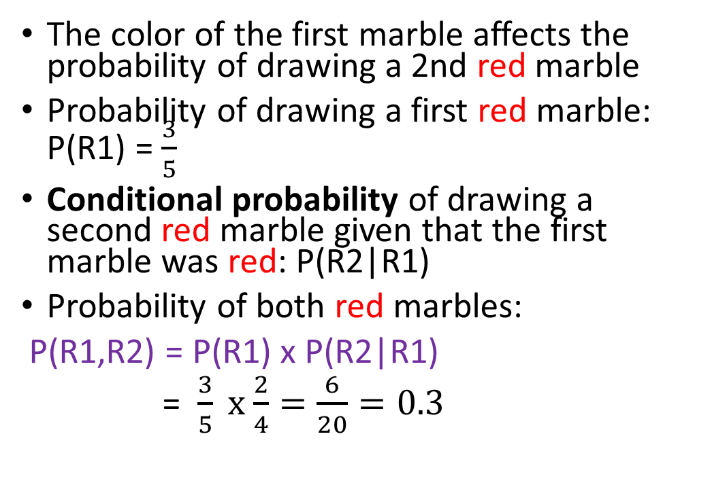
Joint Probability of Dependent Events
Dependent event: The outcome of Event A impacts the outcome of Event B
A jar contains 2 blue marbles and 3 red marbles
If you take two marbles out of the jar without putting the first one back, what is the probability that they are both red?
The color of the first marble affects the probability of drawing a 2nd red marble
Probability of drawing a first red marble: P(R1) = $\frac{3}{5}$
Conditional probability of drawing a second red marble given that the first marble was red: P(R2|R1)
Probability of both red marbles:
P(R1,R2) = P(R1) x P(R2|R1)
= $\frac{3}{5} x$ $\frac{2}{4}=\frac{6}{20}=0.3$

Slide 29
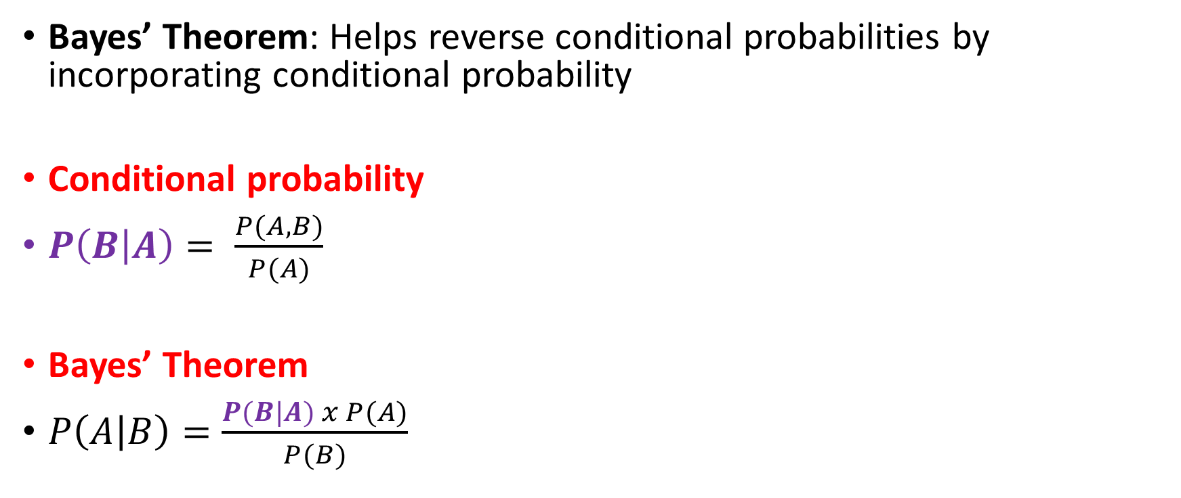
Conditional Probability to Bayes’ Theorem
Bayes’ Theorem: Helps reverse conditional probabilities by incorporating conditional probability
Conditional probability
$P\left(B | A\right)= \frac{P(A,B)}{P(A)}$
Bayes’ Theorem
$P\left(A | B\right)=\frac{P(B|A) x P(A)}{P(B)}$

Slide 30
Bayes’ Theorem Example
10% of patients entering a clinic have liver disease
5% of patients entering a clinic are alcoholic
Out of the patients who have liver disease, 7% are alcoholics
A = Liver disease; So P(A) = 0.10
B = Alcoholic; So P(B) = 0.05
B|A = Patient is alcoholic, given that the patient has liver disease; So P(B|A) = 0.07
Find P(A|B), i.e. probability that the patient has liver disease, given that the patient is alcoholic

Slide 31
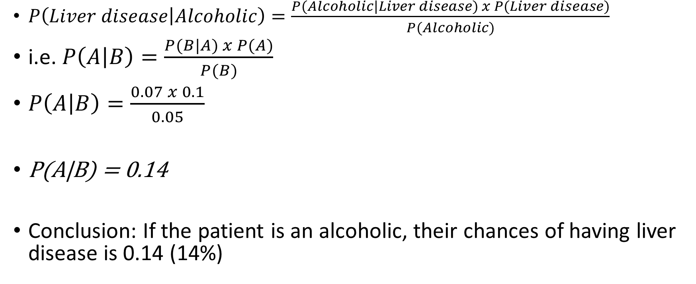
Bayes’ Theorem Example
$P\left(Liver disease | Alcoholic\right)=\frac{P(Alcoholic|Liver disease) x P(Liver disease)}{P(Alcoholic)}$
i.e. $P\left(A | B\right)=\frac{P(B|A) x P(A)}{P(B)}$
$P\left(A | B\right)=\frac{0.07 x 0.1}{0.05}$
P(A|B) = 0.14
Conclusion: If the patient is an alcoholic, their chances of having liver disease is 0.14 (14%)

Slide 32
Bayes’ Theorem Example
Rain prediction
Overall historical probability of rain: P(R) = 0.30
Sky condition
P(Overcast|Rain) = 0.8
P(Clear-sky|Rain) = 0.2
P(Overcast) = 0.6
Find P(Rain|Overcast), because today it is overcast
Suppose A = Rain, B = Overcast sky condition

Slide 33
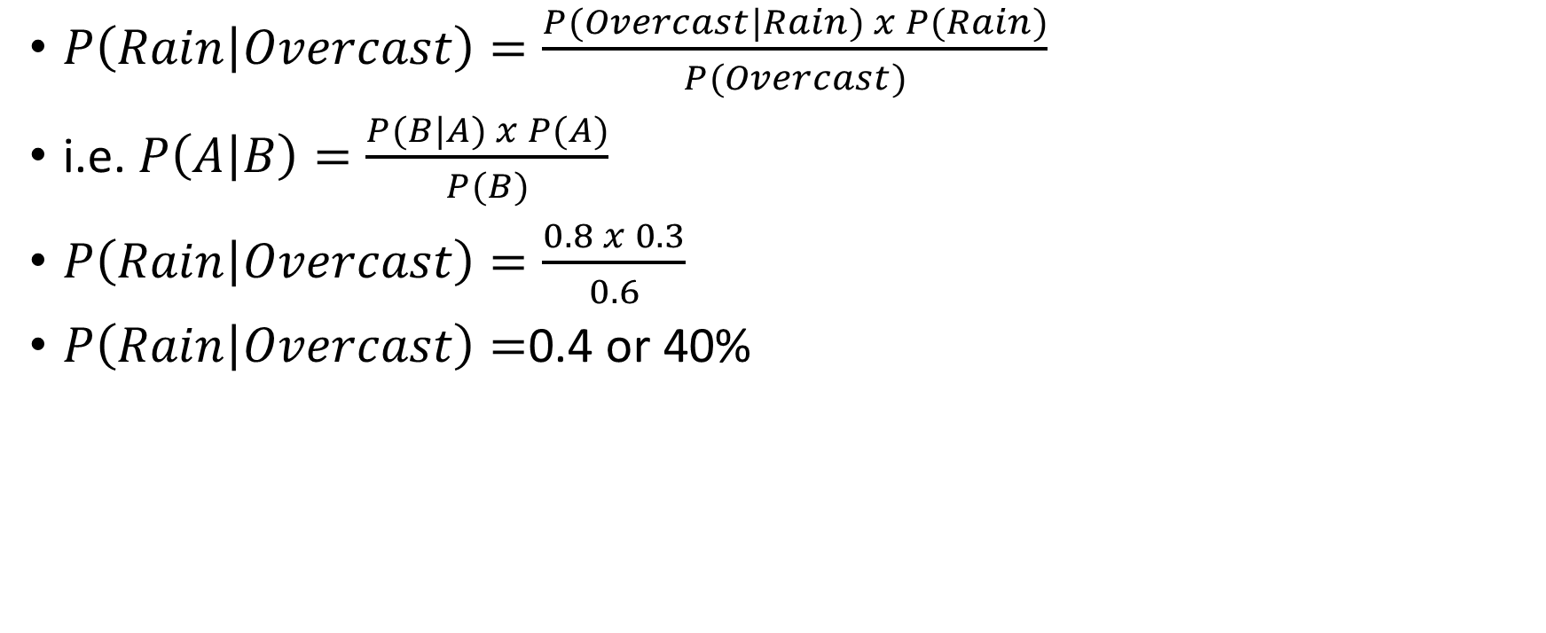
Bayes’ Theorem Example
$P\left(Rain | Overcast\right)=\frac{P(Overcast|Rain) x P(Rain)}{P(Overcast)}$
i.e. $P\left(A | B\right)=\frac{P(B|A) x P(A)}{P(B)}$
$P\left(Rain | Overcast\right)=\frac{0.8 x 0.3}{0.6}$
$P\left(Rain | Overcast\right)=$0.4 or 40%

Slide 34
Bayes’ Theorem
Dangerous fires are rare (1%)
Smoke is quite common due to barbecues (10%)
90% dangerous fires cause smoke
What is the probability that we have a dangerous fire when there is smoke?

Slide 35
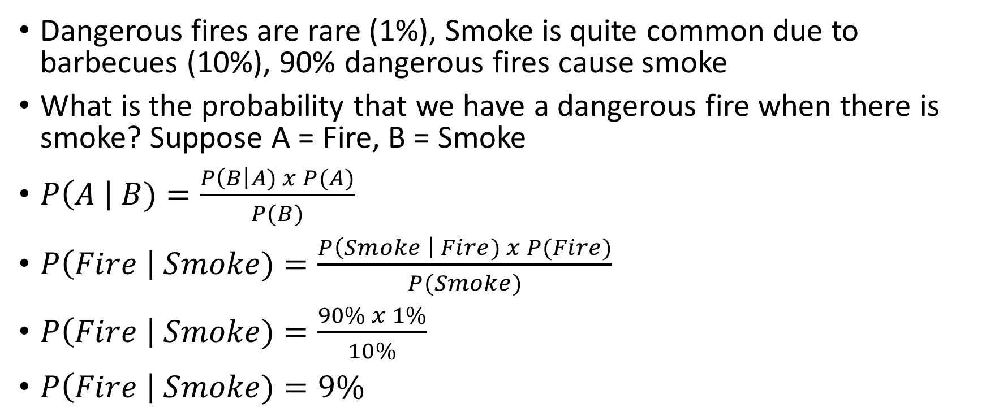
Bayes’ Theorem
Dangerous fires are rare (1%), Smoke is quite common due to barbecues (10%), 90% dangerous fires cause smoke
What is the probability that we have a dangerous fire when there is smoke? Suppose A = Fire, B = Smoke
$P\left(A \right| B)=\frac{P\left(B\right|A) x P(A)}{P(B)}$
$P\left(Fire \right| Smoke)=\frac{P\left(Smoke \right| Fire) x P(Fire)}{P(Smoke)}$
$P\left(Fire \right| Smoke)=\frac{90\% x 1\%}{10\%}$
$P\left(Fire \right| Smoke)=9\%$

Slide 36
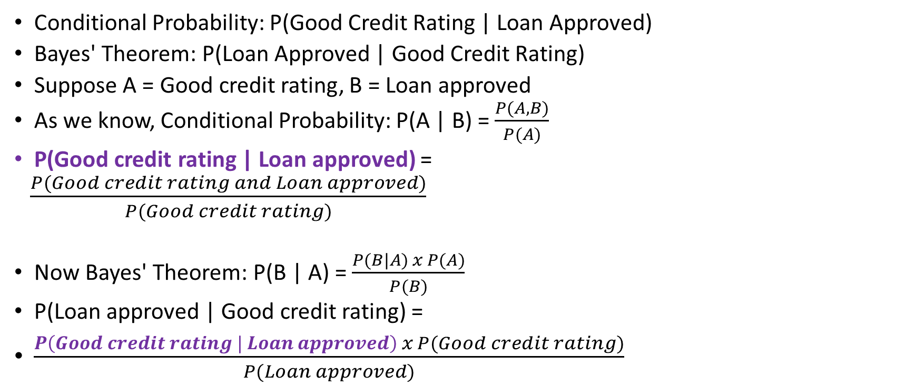
Conditional Probability to Bayes’ Theorem
Conditional Probability: P(Good Credit Rating | Loan Approved)
Bayes' Theorem: P(Loan Approved | Good Credit Rating)
Suppose A = Good credit rating, B = Loan approved
As we know, Conditional Probability: P(A | B) = $\frac{P(A,B)}{P(A)}$
P(Good credit rating | Loan approved) =
$\frac{P(Good credit rating and Loan approved)}{P(Good credit rating)}$
Now Bayes' Theorem: P(B | A) = $\frac{P(B|A) x P(A)}{P(B)}$
P(Loan approved | Good credit rating) =
$\frac{P\left(Good credit rating | Loan approved\right) x P(Good credit rating)}{P(Loan approved)}$

